Slide 1


Commodity Stock Recommendations and Price Prediction using Prescriptive Analytics Techniques
Sinhgad Technical Education Society’s Smt. Kashibai Navale College of Engineering,Pune
Presented By –
Pragati Bankar - 18U417
Vishal Wankhede - 18U420
Harish Hatmode - 18U424
Onkar Kulkarni - 18U426
Guided By
Dr. K.N. Honwadkar

Slide 2
Index
View Point
Scope
Feasibility
Risk Management

Slide 3
View Points
End Users –
Who are they ?
2W2H

Slide 4
Scope
Needs –
It helps in deciding investment proposals .
It is essential for making proper arrangements for training the man-power.
It helps to achieve targets.
It helps in improving and speed up product delivery.

Slide 5
Scope
Description –
For particular raw product take input dataset and set of ‘some’ number of algorithms.
Model builder works on input dataset and algorithms provided to it.
Best algorithm applies on the output derived from model builder.
Due to this accuracy and efficiency of product will be increased.
Final output.

Slide 6
Scope
Objectives –
The objectives or goals of the project should be “SMART”.
Accuracy and Reliability.
To achieve Effectiveness.
To achieve best possible revenue by Data Mining.

Slide 7
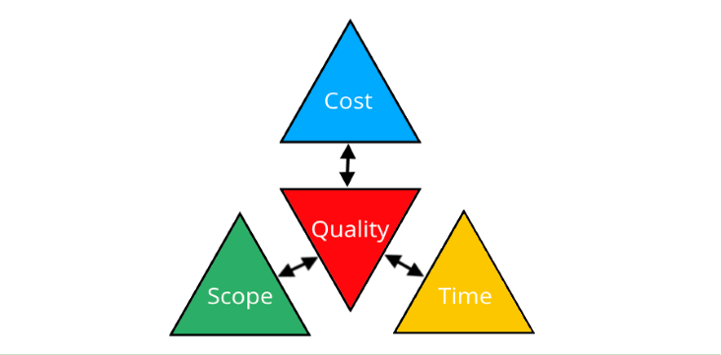
Scope
Constraints -

Slide 8
Feasibility
Types of Feasibility
Technical Feasibility
Economical Feasibility
Operational Feasibility
Schedule Feasibility

Slide 9
Risk Management
Best Strategy for the system can be “WHAT IF?”
Oversee the plan and ensure that employees understand their role in managing the risk.
Document all critical business processes and identify potential risk such as natural disasters, financial difficulties and leading competitors.
Finally review your plan regularly to identify new risks and monitor the plans effectiveness.

